Slide 1
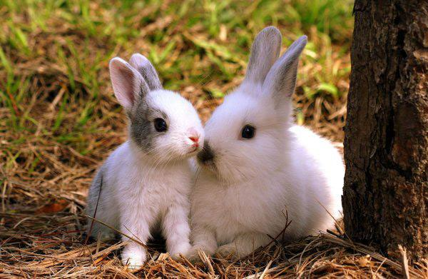
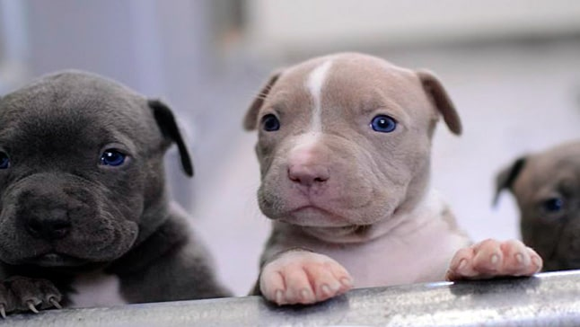
CALENDARIO 2019
JUNE
JULY
Diana Katherine Cruz Lemus

Slide 2

RABBIT-MUSEO DE LA PAPA
2019
The museum of the Pope consists of an exhibition of different native potatoes that allows to appreciate some varieties, to know what are their characteristics and their flavor
JUNE
It is characterized for having a body covered with a thick and shaggy coat , of pale gray to gray color, oval head and big ears.
The males have a wider head tan the female .
*Period of life=9 years
*Measures= 34 to 50 cm
*Weight = varies 1,2 to 2,5 kg
Ears measure = 4 to 8 cm.
Mammal.
S | M | T | W | T | F | S
 |  |  |  |  |  | 1 one
2 two | 3 three | 4 four | 5 five | 6 six | 7 seven | 8 eight
9 nine | 10 ten | 11 eleven | 12twelve | 13 thirteen | 14 fourteen | 15 fifteen
16 sixteen | 17 seventeen | 18 eighteen | 19 nineteen | 20 twenty | 21 twenty-one | 22 twenty two
23 twentytheree | 24 twenty four | 25 twenty five | 26 twenty six | 27 twenty seven | 28 Twenty eight | 29 twenty nine
30 thirty

Slide 3
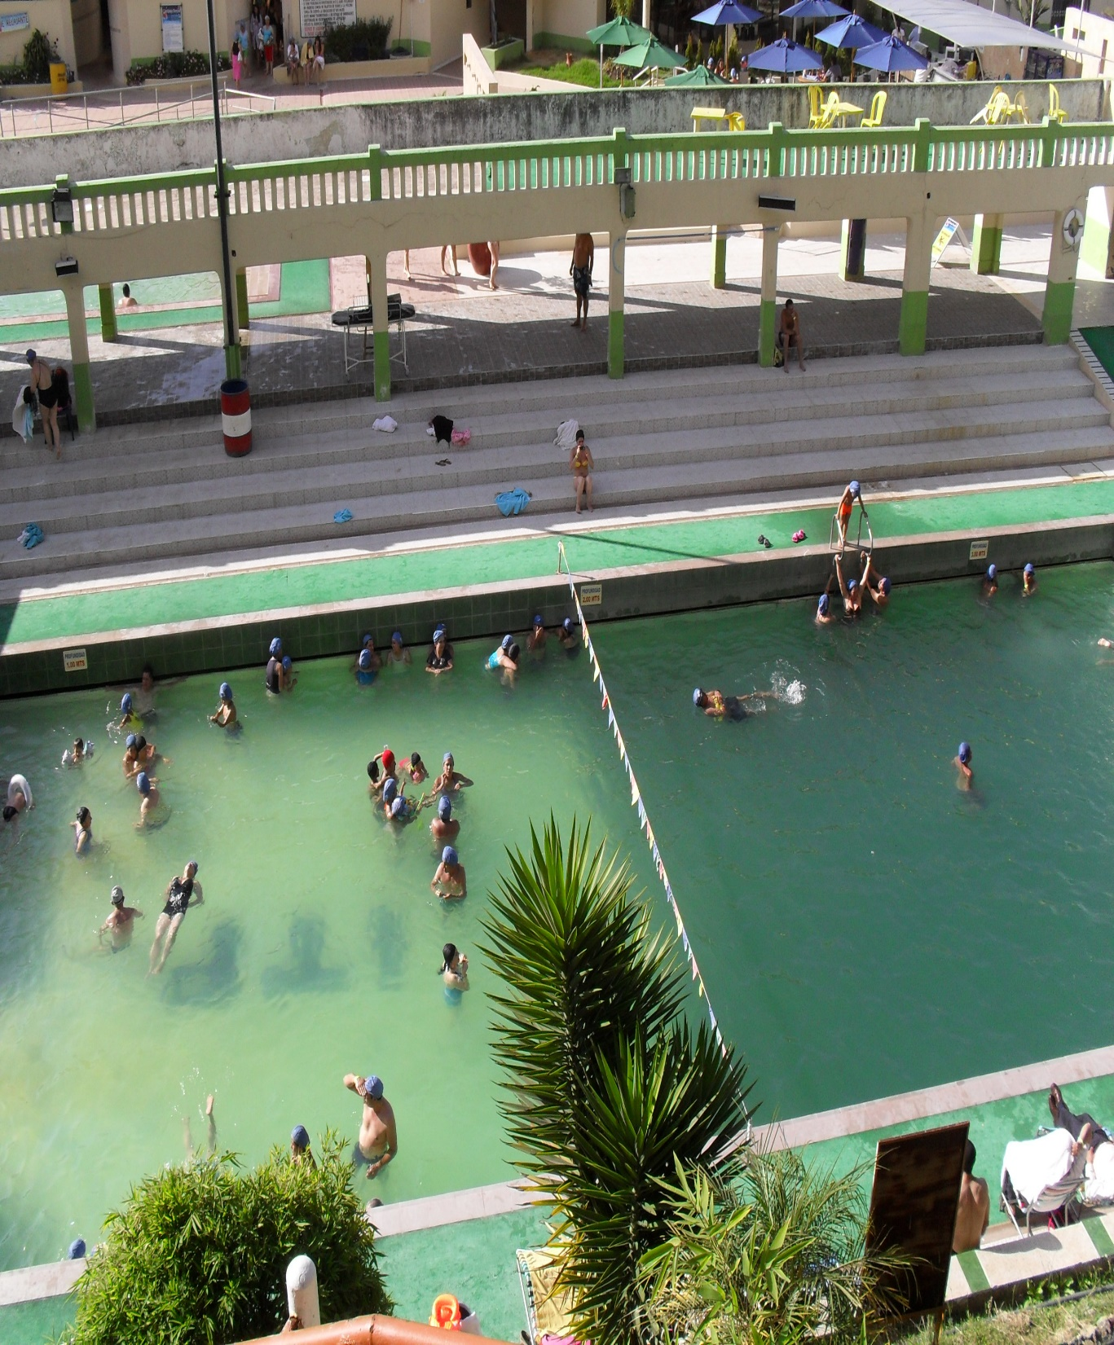
TERMALES DE GUASCA
Guasca is a municipality of Colombia located in the Department of Cundinamarca, fifty kilometers from Bogotá DC It has an average temperature of 15º centigrade and is located at an altitude of 2,700 meters above sea level, located between the cold and páramo thermal floors
2019
JULY
S | M | T | W | T | F | S
 | 1 one | 2 Two | 3 three | 4 four | 5 five | 6 six
7 seven | 8 eight | 9 nine | 10 ten | 11 eleven | 12 tweleve | 13 thirteen
14 fourteen | 15 fifteen | 16 sixteen | 17 seventeen | 18 eighteen | 19 nineteen | 20 twenty
21 twenty one | 22 twenty two | 23 twenty three | 24 twenty four | 25 twenty five | 26 twenty six | 27 twenty seven
28 twenty eight | 29 Twenty nine | 30 thirty | 31 Thirty one
Life time= 8 to 15 years.
It is a mammal.
Female weight= 13,6 and 22,7 kg.
Male weight= 15,9 to 27,2 kg.
Male height=45 to 53 cm.
Female height= 14 to 27 cm.
DOG

Slide 4
Enlace del audio
https://s19.aconvert.com/convert/p3r68-cdx67/ygkyh-kntg0.mp3

